Slide 1



Kitsap Health Equity Collaborative
July 21, 2026
Erica Whares
Equity Coordinator
Equity & Performance
Jessica Guidry
Assistant Division Director
Public Health Infrastructure

Slide 2

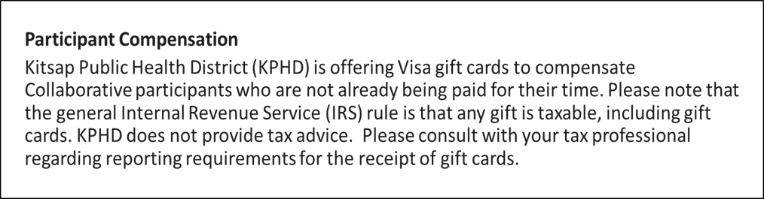
Welcome
kitsappublichealth.org
Notes:
Optional section divider; photo can be replaced using right click > Change Picture

Slide 3
Agenda
Welcome and reminders
Community Needs Assessment updates
Community updates and share-out
HEC updates
Group feedback
Closure
kitsappublichealth.org

Slide 4

KPHD updates
Take it away, Jessica!
kitsappublichealth.org
Notes:
Optional section divider

Slide 5
KPHD updates
July Kitsap Public Health Board meeting updates:
  Kratom
  Ebola
  Paralytic Shellfish Poisoning
  KPHD measles videos in Mam and Spanish (stopmeasles.org)
  PCHS update
KPHD 2027 Budget
  Initial budget to be presented to KPH Board at November meeting
  Final budget to be presented to KPH Board at December meeting
kitsappublichealth.org

Slide 6
KPHD updates
Monthly Health Officer update email newsletter
Partnering with KCR on Community Needs Assessment
Bats
kitsappublichealth.org
Notes:
Will share information about events in

Slide 7

Health Equity Collaborative
OUR VISION
Everyone in Kitsap County can achieve their optimal health and safety, and no one is disadvantaged in achieving these outcomes because of systemic inequities or systems of oppression, including racism.
OUR MISSION
The Kitsap Health Equity Collaborative convenes to identify and implement shared solutions and collective actions, promote pro-equity policies, and amplify the voices of communities most affected by systemic inequities, including racism.
kitsappublichealth.org
Notes:
We will start with the HEC’s vision/mission slide to ground ourselves in why we are here.

Slide 8
Collaborative Agreements
Respect:
We will use respectful and inclusive language to honor different lived experiences and perspectives, recognize individual biases and systems/ structures of oppression, assume good intent, and distinguish that intent doesn’t negate impact, and keep sensitive information shared at meetings confidential.
Consensus:
We understand consensus is desired as the decision-making process and that differing opinions are part of the process, and while majority vote will determine next steps, the opinions of those in the minority will be honored by members with respect, inclusion, and open-mindedness.
Inclusion and
Open-mindedness:
We will honor the contributions of all members and seek and value every person’s input by ensuring everyone has a chance to comment and by being open to different and opposing perspectives and opinions.
kitsappublichealth.org
Notes:
Do I have a volunteer or volunteers to read the collaborative agreements to set the tone for our meeting?

Slide 9

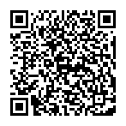
kitsappublichealth.org
Notes:
Optional section divider

Slide 10

Share out
Any organizational updates to share?
What upcoming events do you have?
kitsappublichealth.org
Notes:
Optional section divider

Slide 11
HEC updates
KPHD will no longer convene the HEC after our September meeting.
But this does not mean that our work with community is ending
We are looking forward to continuing to partner with you and your organizations.
We would like to hear from you what collaboration could look like, including connecting you with KPHD programs for information and community engagement opportunities.
We would also like to hear your reflections on your experience being a member of the HEC.
kitsappublichealth.org

Slide 12
Our journey
Launched in 2022 to “co-create solutions to systemic inequities”
Agreed on group mission, vision, group agreements, and priority topic areas
Had guest speakers from multiple community organizations
Began workgroups – 1 per priority area
kitsappublichealth.org

Slide 13
Where we go from here
Before we co-create, we need to foster relationships in and with our community and learn from each other
We feel honored to have been able to provide a space for collective sharing and learning about health inequities and the incredible community resources we have in Kitsap County.
Though the work may look different, we still want to partner, collaborate, and learn from and with you!
kitsappublichealth.org

Slide 14
Group feedback and discussion
Reflections on where we’ve been and where we’re going
kitsappublichealth.org
Notes:
Optional section divider

Slide 15
Feedback guiding questions
What about the Health Equity Collaborative has been most valuable to you?
What messages would you like to share with leaders at KPHD related to the Health Equity Collaborative?
What would you have changed about the HEC?
How would you like to continue to stay in touch with KPHD?
Is there anything else you'd like us to know?
If you are interested in continuing to come together as a group and can facilitate these gatherings, or know another organization who can do this, please come to the July 21st HEC meeting with your suggestions.

Slide 16

Heads up: September meeting
We will have a celebration potluck during our September meeting
Tuesday, September 15th from 1:30 – 2:30 pm in the Norm Dicks Government Center Chambers
We hope to see you there!

Slide 17

THANK YOU!
equity@kitsappublichealth.org
kitsappublichealth.org

