Slide 1



Kitsap Health Equity Collaborative
March 18, 2025
Erica Whares
Equity Program Coordinator
Kari Hunter & Kat Alexander
Assessment & Epidemiology
Notes:
Alternate title slide; vertical blue line can be moved and adjusted

Slide 2

Welcome
kitsappublichealth.org
Notes:
Optional section divider; photo can be replaced using right click > Change Picture

Slide 3
Agenda
Welcome, recognition, and reminders
HEC Membership Guide updates
Workgroup share-outs
KPHD Epidemiology Team’s presentation on Presenting local public health data by race and ethnicity
Break
Share out
Wrap up
kitsappublichealth.org

Slide 4

Health Equity Collaborative
OUR VISION
Everyone in Kitsap County can achieve their optimal health and safety, and no one is disadvantaged in achieving these outcomes because of systemic inequities or systems of oppression, including racism.
OUR MISSION
The Kitsap Health Equity Collaborative convenes to identify and implement shared solutions and collective actions, promote pro-equity policies, and amplify the voices of communities most affected by systemic inequities, including racism.
kitsappublichealth.org
Notes:
Stock vision/mission slide; image can be changed using right click > Change Picture

Slide 5

Collaborative Agreements
Respect:
We will use respectful and inclusive language to honor different lived experiences and perspectives, recognize individual biases and systems/ structures of oppression, assume good intent, and distinguish that intent doesn’t negate impact, and keep sensitive information shared at meetings confidential.
Consensus:
We understand consensus is desired as the decision-making process and that differing opinions are part of the process, and while majority vote will determine next steps, the opinions of those in the minority will be honored by members with respect, inclusion, and open-mindedness.
Inclusion and
Open-mindedness:
We will honor the contributions of all members and seek and value every person’s input by ensuring everyone has a chance to comment and by being open to different and opposing perspectives and opinions.
kitsappublichealth.org
Notes:
Optional section divider

Slide 6
Quick update
Erica will be going on parental leave this summer and early fall
  Workgroups and facilitation for HEC will continue with help from others at KPHD
  Helpful to email equity@kitsappublichealth.org instead of my individual email (it gets sent to the whole KPHD equity team)
kitsappublichealth.org

Slide 7

HEC Membership Guide Update
kitsappublichealth.org
Notes:
Optional section divider

Slide 8
Why a membership guide?
Provides clearly outlined procedures and expectations for the HEC
Facilitates onboarding for new members
Helps us solve problems and build community together
Important note: this is a living document and can be updated as needed
  The KPHD Equity team will plan to review the HEC Handbook annually and share any changes
kitsappublichealth.org

Slide 9
Updates
Edited language:
  ‘May’ or ‘should’ instead of ‘must’
  Updated wording throughout to use more plain language
  Updated wording on how to let our team know about attendance/alternates
New titles for several sections:
  ‘Membership Guide’ instead of Handbook
  ‘Who We Are’ instead of Membership Guidelines
  ‘How to Get Involved’ instead of Recruitment and Selection Process
  ‘Ways to Participate’ instead of Roles and Responsibilities (including a note to share back with the community what is learned in this space)
kitsappublichealth.org

Slide 10
Updates
Moving forward, we are able to offer compensation to HEC members who are 18 years or older who are not being paid for their time.
We will only compensate HEC members for their participation.
kitsappublichealth.org

Slide 11



Workgroups
Accessible Medical Care
Accessible Mental Health Services
Affordable Housing
kitsappublichealth.org
Notes:
Optional section divider

Slide 12
Epi Presentation
kitsappublichealth.org
Notes:
Optional section divider

Slide 13
Presenting local public health data by race and ethnicity:
A Discussion with the Health Equity Collaborative
Kari Hunter, DVM, MPH, DACVPM
Program Manager
Assessment & Epidemiology
Epi@kitsappublichealth.org
Katharine Alexander, MPH
Epidemiologist
Assessment & Epidemiology
Notes:
We have quite a bit of our work that we want to share with you today and we have a couple of discussion question where we would love to hear from you. We’d appreciate your feedback however you want to give it. We have an online poll set up if you want to contribute that way, the QR codes are on your tables and if you're online, hopefully you'll see them online once the question is asked. We would also love to hear from you in person, so when we get to those sections, we'll have time for questions, comments, complaints, ideas, anything you want to talk about more. If you think of something later after this meeting, I’m hoping you will continue to share your thoughts with us as we move forward. We will talk more at the end about what next steps look like. So to jump right in, [introductions].

Slide 14
What is epidemiology or "epi?”
The study of how and why specific populations experience health risk factors and outcomes, and the use of this information to improve health.
Sources: Centers for Disease Control and Prevention (CDC). Introduction to Public Health. In: Public Health 101 Series. Atlanta, GA: U.S. Department of Health and Human Services, CDC; 2014. Available at: https://www.cdc.gov/publichealth101/epidemiology.html.
kitsappublichealth.org/data
Notes:
I'm an epidemiologist. Epidemiology is one of the core sciences of public health and considered one of the foundational public health services that residents can expect to have available regardless of where they live in the United States. Everyone seems to know what epidemiology is these days, since COVID, but it doesn't seem everyone agrees. I love this definition from the Centers for Disease Control and Prevention, because it encompasses 2 aspects of epidemiology. It is the study of how and why specific populations experience health risk factors and outcomes, and then using this information to improve the health of populations. The study is focused on identifying trends or patterns in data across populations, places or locations, and timeframes. And it means nothing unless we then use that information to improve our health and wellbeing.

Slide 15
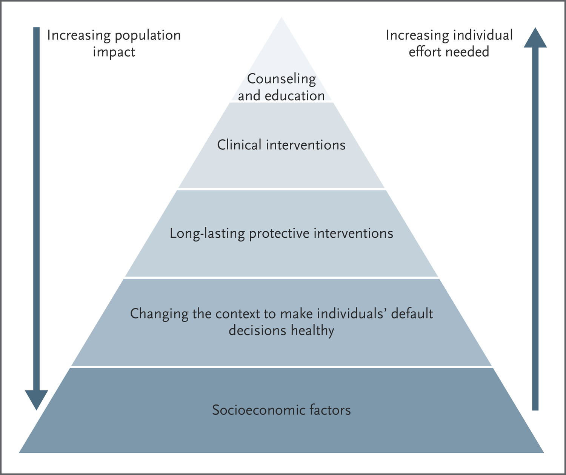
What is public health?
Public Health Impact Pyramid
Goal is to protect and promote the health of all people in all communities
Ensure everyone has a fair and just opportunity to achieve good health and well-being
Sources: 1. CDC, the 10 Essential Public Health Services, 2020, accessed at https://phaboard.org/wp-content/uploads/EPHS-Graphic-Image.png. 2. Frieden, T. 2015, The Future of Public Health, NEJM
Notes:
Epidemiology is a foundational part of public health. The goal of public health is to protect and promote the health of all people in all communities, and ensure that everyone has a fair and just opportunity to achieve good health and well-being.
This pyramid comes from the Centers for Disease Control and Prevention, again. As you go from top to bottom in prevention efforts, you increase the impact you have on a population, whereas, as you go closer to the top, you increase your work at the individual level. We typically think about public health working at the population level to understand health trends and take action to protect and promote the community’s health. A lot of this work happens closer to the base of this health impact pyramid, where we work to understand and change the context of people’s lives to better promote health. In contrast, healthcare and medicine typically work at the individual level, higher up on this pyramid, to understand individual level health status and take action to protect and promote an individual’s health.

Slide 16
Our Long-term Goals
Improve the extent to which Kitsap’s diverse communities and identities are reflected in local public health data
Ensure these data are useful and accessible for KPHD programs, community partner organizations, and residents
Our Purpose Today
Gather community input on presenting data grouped by race and ethnicity
kitsappublichealth.org/data
Notes:
Project goals
Improve the extent to which Kitsap’s diverse communities and identities are reflected in local public health data, and
Ensure that these data are useful and accessible for community members and organizations
Purpose of today’s session:
Discuss key epidemiologic principles that inform how we present population level data
Gather community input on presenting population level data grouped by race and ethnicity
In addition to meeting with you here today, we also met with representatives from other groups and organizations to talk about presenting population level data. We'll be talking to you today about some of the things we have learned, and hopefully get your thoughts on it. We’d really like to meet with any other group that is interested in local public health data. We’ll be taking all of this feedback and information that you share with us today to incorporate into our next versions of the health indicators displayed on KPHD’s website, as well as data we compile for future community health assessments.

Slide 17



Why KPHD uses race/ethnicity data
Identify disparities and strengths between subgroups
Allocation of resources
Proxy for metrics that are harder to measure
kitsappublichealth.org/data
Notes:
Identify disparities and strengths between subgroups
Example: Washington had the 11th highest life expectancy in 2021 among the United States. Kitsap had ss higher life expectancy than WA, but there are significant disparities by race/ethnicity, some below the national average.
Allocation of resources:
Needs identified in data provide evidence which can lead to KPHD leadership assigning more personnel hours or other resources, like vaccines or test kits, to specific work in a community affected. Example would be the Black Infant Thrive project created to provide more personnel hours in supporting perinatal Black infants and their families.
Proxy for metrics that are harder to measure:
Proxy: something that represents or stands in for something else, especially when the original is difficult to measure
Systemic racism: examples: within the criminal justice system, healthcare system

Slide 18


Discussion
Is it important to see health metrics by race/ethnicity?
  (Poll # 1 at your tables)
How have you seen race/ethnicity data used?
  What are the benefits and limitations?
kitsappublichealth.org/data
Notes:
Just to really step back to the fundamentals, the first question we want to ask you today is “is it important to you or your work to have access to health metrics by race and ethnicity?” This is the first poll on your tables.
We’d love to hear from you on how you have seen race/ethnicity data used? How do you feel about race/ethnicity data being used? What are the benefits and limitations?

Slide 19
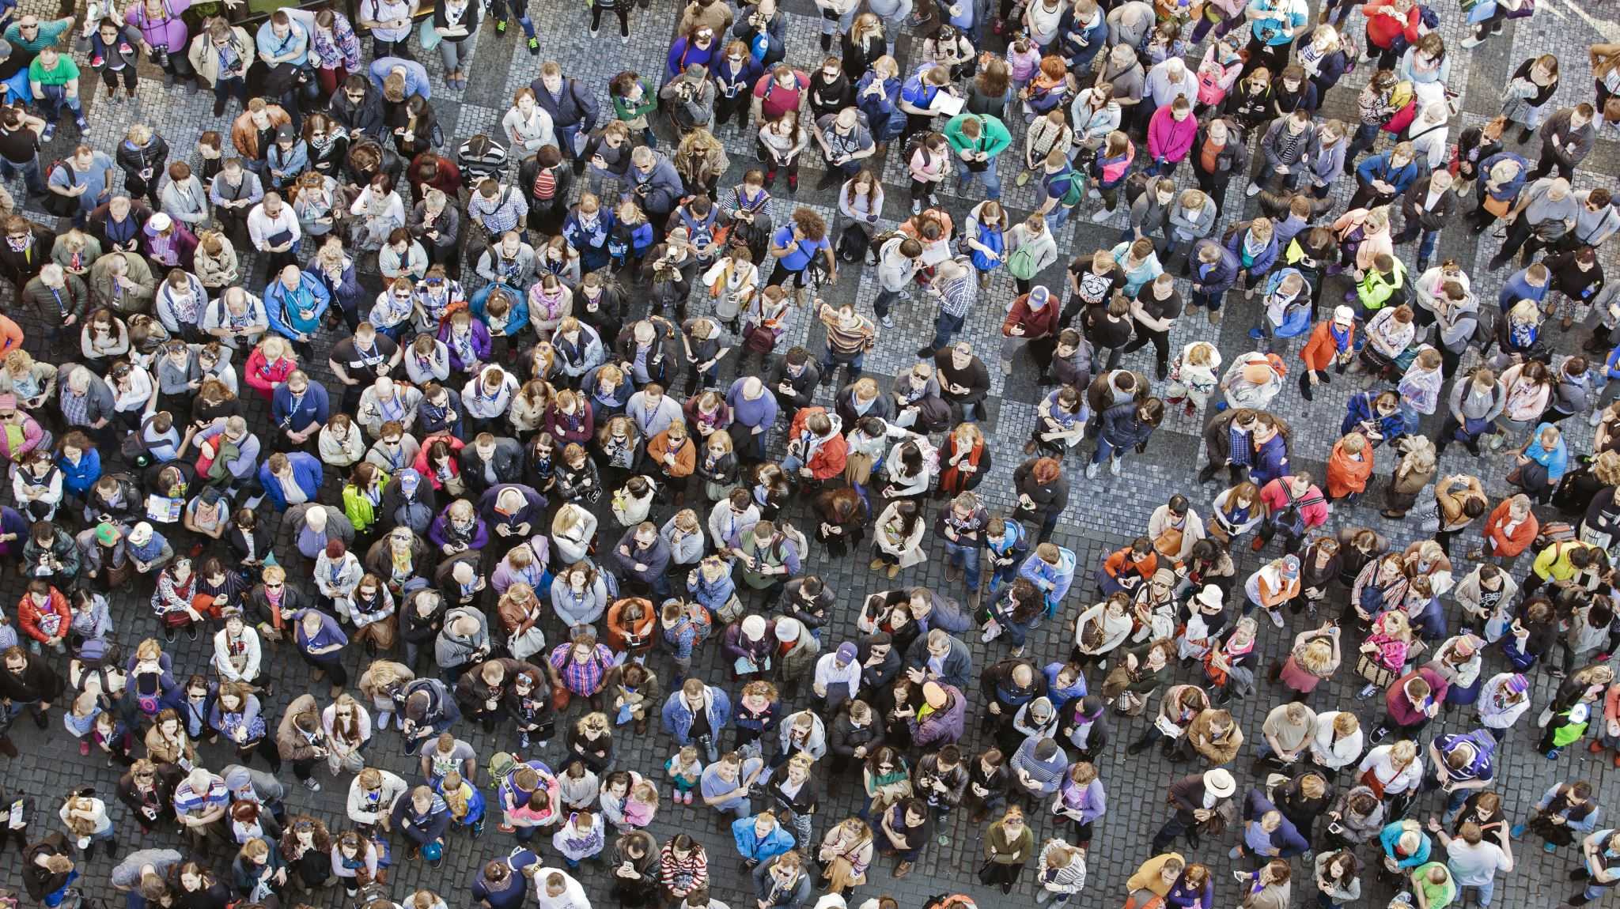
Population-level data
Notes:
Our indicators/metrics primarily use population level data, and we wanted to spend some time familiarizing with you what we mean by population-level data.
We also want to review population level data to discuss other options for engaging with data

Slide 20
Population-level data
What is it? What is it not?
  Does not highlight individual experiences
  Does represent the majority experience of a large group or community
Examples of this data
Limitations
Sources:
kitsappublichealth.org/data
Notes:
What is a population? It can be any group or community within a larger community, but it represents the majority experience of that group (or a generalization of the community) and may not represent individual experiences.
Examples of this data:
Birth certificates
Death certificates
Behavioral Risk Factor Surveillance System (BRFSS) survey
Healthy Youth Survey (HYS)
American Community Survey (ACS)
Limitations: by grouping data, we lose individual experiences, and trends we see may not explain the whole picture. Data is representative of those who participate in the data collection and can be affected by participants wanting to appear socially acceptable or wanting to emphasize their point.
Example: student bullying (HYS data) (Kari: we don't have bullying up on our website.)
Overall trend showed a decrease in bullying, data by race/ethnicity doesn't show disparities (African American bullying percentage is lower (but not statistically significant) than White), but perception that bullying is a concern for Black community.
Important to remember that just because no disparities exist, doesn't mean it isn't a concern for community. The data only tells relative differences in metrics, not the importance of the issue to the community.
Value of qualitative data, which is detailed individual experience data, which provides more about importance, causes, and barriers, more detailed picture

Slide 21
Population-level data
Why is population data grouped?
Tells us about general trends and experiences within that group
Informs programs, services, policies to address specific needs
Groups can be defined by, for example:
County
Age
Gender/Sex
Race and ethnicity
Income
kitsappublichealth.org/data
Notes:
Requires grouping people by factors relevant to public health
Benefit of population-level data is that it puts each of our experiences into context, how do we compare to our group's average, how does the group's average compare to the county average, the state average, the national average. Simplifies experiences of lots of people down to a generalization that is bigger-picture and easier to make decisions about.

Slide 22

How can we enhance population data?
kitsappublichealth.org/data

Slide 23

Advocacy and outreach for increased participation
Example: Healthy Youth Survey in local schools
Aim to increase awareness and trust of the survey
Advocate for changes in type of data collected and/or methods
kitsappublichealth.org/data
Notes:
Talk about HYS as an example of surveys administered by the schools – room for improvement on how many schools and students participate
Encourage a stronger connection with teachers, schools, districts
Today, our focus is on how we display data, but there are other aspects of data collection where the community can be involved like with helping with participating in data collection (surveys, etc.), as well as qualitative projects.

Slide 24

Role of qualitative data: bridge the gap
To learn more about specific topics, communities or groups, we collect qualitative data - detailed accounts of experiences, stories, and perceptions.
Interviews, focus groups, listening sessions, other
Identify focus for qualitative data collection on a particular topic or with a particular subgroup (e.g., youth tobacco use)
Notes:
If we don’t think we’re seeing the bigger picture, that’s when we use qualitative data (don’t know enough information about a specific group etc.)

Slide 25

Defining and Comparing Groups
kitsappublichealth.org/data
Notes:
So in looking at population level data, we naturally have to combine people into groups. Let’s look at what the data we currently have entails. And I wanted to bring up an issue I have heard feedback about in our community.
Sometimes we conduct a survey or listening sessions in our community, and we can do anything we like with that data, but much of our data is pulled from other sources. These data sources are often limited in terms of the types of race categorization available, here’s an example…

Slide 26
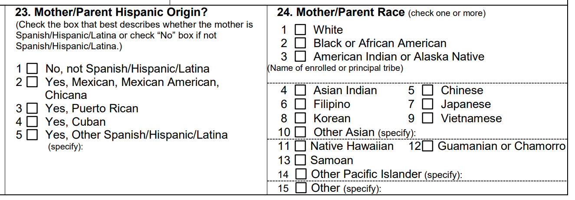
Race and ethnicity in common data sources
Birth certificates
Source: 422-020-WashingtonStateBirthFilingForm.pdf
kitsappublichealth.org/data
Notes:
For example, this is the set of questions collected on race and ethnicity for birth certificates. This information is self-reported race/ethnicity from the person who gave birth and sometimes comes from the medical record.
Walk through categories briefly.
Each data source has it’s own way to collecting race and ethnicity information and some have more categories, some less, and for each type of data, we’re limited based on what they collect.

Slide 27
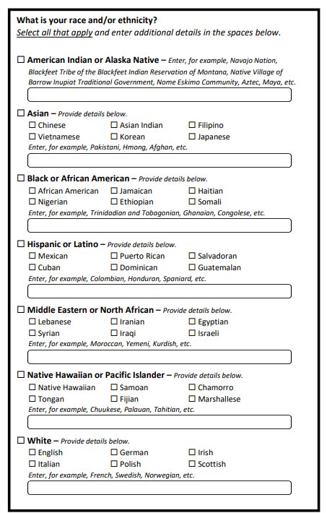
New categories in data sources
“Middle Eastern or North African”
“Hispanic or Latino”
Added to 2030 Census race/ethnicity
Also 2023 Healthy Youth Survey
Sources: 1) https://www.nytimes.com/interactive/2024/02/25/us/census-race-ethnicity-middle-east-north-africa.html; 2) https://www.npr.org/2024/03/28/1237218459/census-race-categories-ethnicity-middle-east-north-Africa; 3) https://www.federalregister.gov/d/2024-06469
kitsappublichealth.org
Notes:
It is also worth pointing out there are changes coming to large standardized surveys like the 2030 Census and more local surveys like Healthy Youth Survey and Behavioral Risk Factor Surveillance System to include a new race category option (MENA), and to consider Hispanic or Latino as a race and/or ethnicity that is presented along with the other races previously listed.
These changes are the result of many years of advocacy for this change at the national level for the Census. Over time as people start to self-report their race/ethnicity with these additional options, it will open up opportunities to better understand and monitor health trends within these groups specifically.
Although MENA was an option in the 2023 HYS survey, a very small number of students selected this option in Kitsap as one of their races/ethnicities. We expect more people to self report this option in Kitsap as time goes on and people get more used to seeing and identifying with this option.

Slide 28
Current groups in KPHD data
Non-Hispanic or Latino
American Indian/Alaska Native (AIAN)
Asian
Black or African American
Native Hawaiian or Other Pacific Islander (NHOPI)
White
Multiracial
Other race**
Hispanic or Latino
Similar to WA DOH, CDC, Census
Mutually exclusive groups
“Multiracial” and “other race” not particularly informative
**Depends on the specific data source; DOH Center for Health Statistics recodes “other” races when possible for births and deaths data
kitsappublichealth.org/data
Notes:
Based on the response options that are most commonly available, KPHD typically uses these categories when presenting data by race/ethnicity.
The groups align with those reported by WA state DOH, CDC, Census.
The groups are mutually exclusive, so any individual who reports more than 1 race or ethnicity is categorized as "multiracial" which is not ideal (ends up "erasing" any other racial identity a person has in analysis). In addition, the "other" group is also not ideal. Both are not particularly informative for any communities.
KPHD is currently looking into ways to improve this.
Our current preferred idea is to list race and ethnicity alone or in combination (AOIC)
Inclusive categories of race and ethnicity
Example:
An individual identifying as non-Hispanic Black and non-Hispanic American Indian/Alaska Native would be included in both categories
Possible for Births data used by KPHD
Population denominators not currently available
Downside of doing it this way is that it would include all those people who may have a small percentage identification with that group. This may not be ideal for some communities, such as the Tribes.
This issue is something that my team is working on. We’re limited by the data we have available and by not having accurate population denominators. We’ve discussed the population denominator issue with WA DOH and they are working on that. This work is source by source, and not something we have a lot of control over, but we wanted you to be aware of this. As we look at collecting our own data in Kitsap, we should consider how it will add to data from other sources. We would like the opportunity to potentially bring this back as a topic by itself at a later meeting as we get more information.

Slide 29
Comparing groups
We compare health status or events between groups to:
  Contextualize a given measure with a benchmark (e.g., Kitsap compared to WA), or
  Identify and study health disparities and/or health strengths
We compare within groups over time to:
  Understand how a measure is improving or worsening over time
Sources:
kitsappublichealth.org/data
Notes:
We compare between groups to provide context around a measure. How hard will it be to make improvement in this metric? If other populations have lower rates, then perhaps it is possible to achieve lower rates in this population as well. If everyone has similar rates, we know it may be harder to make progress or it’s going to require more wholistic work not specifically focused on this population.
We can also compare how a measure may be changing over time within a subgroup. This can deepen our understanding of health disparities and how other factors are affecting this metric over time in order to guide what public health actions are needed.
Now Kat is going to go over 2 ways to display race and ethnicity data based on the feedback that we have received. We'd appreciate your thoughts on the usefulness of these.

Slide 30
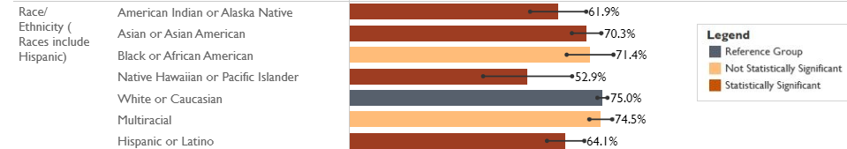
Race/ethnicity data visualization
Original:
kitsappublichealth.org/data
Notes:
KPHD produces annual indicators on our website, at the site at the bottom of the slide (kitsappublichealth.org/data). For these, we standardize how the information appears, so that if you know how to read one of them, you should be able to read any of them.
This is how we currently display race/ethnicity data. You’re looking at the percentage of residents who are age 25 or older who have more than a high school education, so at least some trade school or college. They don’t have to have graduated or hold a certificate or a degree.
Reading it from left to right, it tells you this is the metric by race and ethnicity and it lists each race category. 61.9% of residents who identify as American Indian or Alaska Native in Kitsap had more than a high school education from 2018-2022.
The reference group for this metric is the racial group with the highest percentage of residents with more than a high school education (in this case the reference group is White, with 75%). Each group is compared to the reference group by comparing 95% confidence intervals to determine if they are statistically significantly different, and you can also clearly see the difference between the length of the bars.

Slide 31
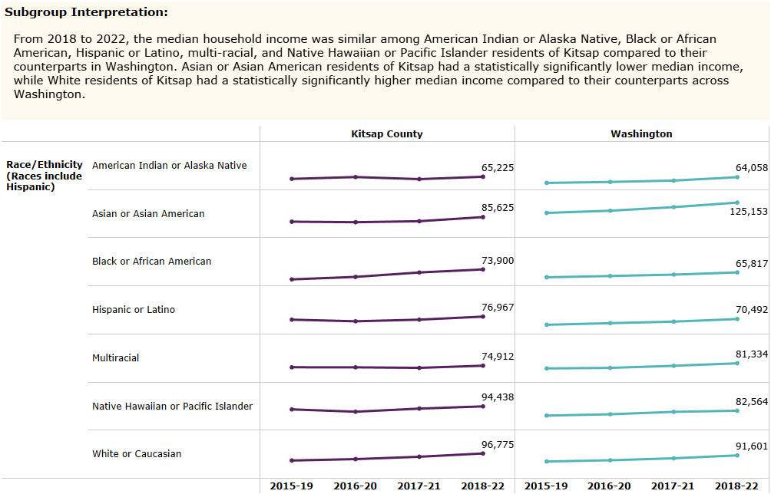
Possible version
Dashboard link
Notes:
Talking points:
Rather than seeing just one year of data, we see median household income for each racial groups over time. We're also not comparing each racial group against each other like in the previous example, but rather comparing each racial group in Kitsap to Washington (for example, what is the median household income among American Indian or Alaska Natives in Kitsap compared to American Indian or Alaska Natives median income in Washington.
Also, while we don't visually show statistical significance (like in the previous graph) we do state this in the interpretation for the most recent year:
“From 2018 to 2022, the median household income was similar among American Indian or Alaska Native, Black or African American, Hispanic or Latino, multi-racial, and Native Hawaiian or Pacific Islander residents of Kitsap compared to their counterparts in Washington. Asian or Asian American residents of Kitsap had a statistically significantly lower median income, while White residents of Kitsap had a statistically significantly higher median income compared to their counterparts across Washington.”
This one looks a little more complicated, as you're seeing multiple data points over time. But based on the feedback we have received so far, we’re playing with this updated version.

Slide 32

When looking at race/ethnicity data, how important is it to see:
Single point in time
More than one year of data (a trend over time)
kitsappublichealth.org/data

Slide 35
Discussion
Any comments about the options you liked best?
kitsappublichealth.org/data
Notes:
Give option to people to write in comments OR come off mute
Are there any questions before we go into our discussion?

Slide 36

KPHD Small Number Standards
Notes:
because we are a medium-sized County, we continuously work with data that gives us small numbers. We would like to go over some of this information with how we typically handle small numbers or samples.

Slide 37
Small numbers in population level data
Some population subgroups may be small in number, and even smaller in survey samples from that group.
Reporting small numbers can cause concern about
  Data reliability (large changes from year to year)
  Confidentiality (the people behind the data)
Sources: Washington State Department of Health, Washington State Office of the Superintendent of Public Instruction, Dept. Of Social and Health Services, and Liquor and Cannabis Board. Healthy Youth Survey, 2021. Analyzed by KPHD Assessment and Epidemiology Program. Accessed at Students who Reported Binge Drinking Alcohol | Tableau Public
kitsappublichealth.org/data
Notes:
Sometimes, when we want to compare estimates between population subgroups, some groups are composed of very small numbers of people.
The numbers can be small enough where we do not feel confident that they could represent what tends to be the experience of the broader population within that subgroup (a concern of data reliability), or we are concerned that people could potentially identify the individuals for whom data are presented.

Slide 38
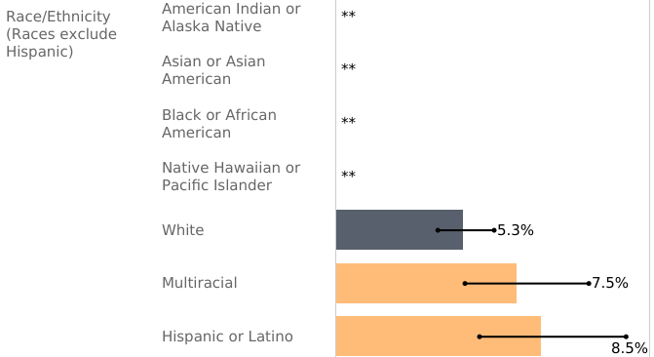
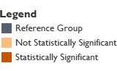
Small numbers in population level data
10th and 12th graders who reported binge drinking alcohol in the past 2 weeks, 2021
Suppressed data due to small numbers
Sources: Washington State Department of Health, Washington State Office of the Superintendent of Public Instruction, Dept. Of Social and Health Services, and Liquor and Cannabis Board. Healthy Youth Survey, 2021. Analyzed by KPHD Assessment and Epidemiology Program. Accessed at Students who Reported Binge Drinking Alcohol | Tableau Public
kitsappublichealth.org/data
Notes:
To give you an example, this graph shows the proportion of students who reported binge drinking alcohol in the past 2 weeks, several race/ethnicity group estimates are suppressed (if the count is less than 10). We do this because if we were to show this information, it could be potentially misleading and potentially identifying for different subgroups, and we want to protect confidentiality.
With such small totals, we are also concerned with how reliable this data is: we do not feel confident that they could represent what tends to be the experience of the broader population within that subgroup. If we were to show unreliable data, especially publicly, this could perpetuate stigma or cause harm to the subgroup.
This is a limitation of quantitative data displayed at a smaller level (in this case at the county level) because the participation in some surveys can be very low for certain population subgroups and this limits our ability to quantitatively represent the experience of that subgroup as a whole.
(summary of above points):
perpetuate stigma or cause harm to the subgroup
Issues of confidentiality/potentially identifying those involved in the survey
We always try to avoid suppression if possible, and there a couple different approaches to achieve this:
Group data over multiple years (this is what we typically do, as you saw in our example earlier when looking at groups over time (5-year roll ups)
Group data over multiple subgroups: we do this most often for regions, ages, and income levels, we try to avoid grouping racial categories together
Pros: we get large enough number to be able to see trends/patterns in populations, we can talk about meaningful comparisons and summaries among 3-10 groups. When the number of groups starts to get beyond 10 or so, we can lose the ability to focus in on population issues (working on population issues is more efficient of resources because it benefits the most people, whereas individual issues have to be addressed one at a time)
Cons: differences in the group are averaged out, so that we miss highs and lows within the group. Every individual in the group may not feel that they are fully represented because it is an average of the group. Important nuances are missed and those in the majority of the group are most represented.
Alternatives:
For our data and some data sources, there is some room for negotiation when sharing data with small numbers, and we can have a conversation about this data (in this case the school district which “owns the data”). May be shared internally versus displayed on public.
Another way to enhance this data is conducting qualitative projects (as we mentioned earlier).
Other notes if want more explanation:
With a large confidence interval, not confident in that data and don't want to be misleading

Slide 39
“Statistical significance”
A statistical test can tell us whether the difference between groups or a change over time is greater than would be expected by chance
95% confidence interval
  A range of estimates that will contain the true value at least 95% of the time
  If a confidence interval for one group overlaps with the confidence interval for another group, we consider the difference between groups to NOT be statistically significant.
Sources: KPHD Epi Data Style Guide; Small numbers analysis & language guidelines, 2nd Edition; Interpretive Guide: Washington State Health Youth Survey 2021.
kitsappublichealth.org/data
Notes:
Statistical significance is also something that may be more challenging to achieve when working with small numbers. This a general definition of statistical significance/95% confidence interval. I’m going to talk about this more in the next slide using an example

Slide 40
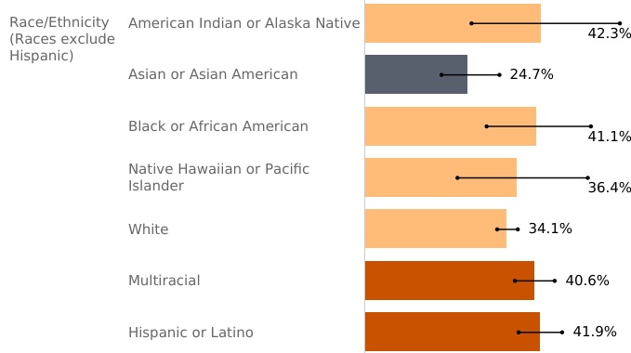

“Statistical significance”
Kitsap 10th and 12th graders who reported feeling depressed in the past 12 months, 2023
Sources: Washington State Department of Health, Washington State Office of the Superintendent of Public Instruction, Dept. Of Social and Health Services, and Liquor and Cannabis Board. Healthy Youth Survey, 2023. Analyzed by KPHD Assessment and Epidemiology Program.
kitsappublichealth.org/data
Notes:
In this example, students who identified as Asian or Asian American are set as the reference group (because they have the lowest prevalence of reported depression as compared to the other groups). The red bars indicate that there is a statistically significant difference between the reference group (ex: the difference in reported depression between Asian/Asian American and multiracial and Hispanic/Latino 10/12th graders). The lighter orange bar indicates that this is no statistically significant difference. A quick way to know if differences will be statistically different is if you look at the black bars and see if they overlap with one another. Since the CIs for Multiracial and Hispanic or Latino groups do not overlap with the CI for the Asian or Asian American group, we consider these differences in the estimates to be statistically significant. Likewise, we do not consider the differences between the other groups and the Asian or Asian American group to be statistically significant because the 95% CIs overlap with one another.
However, this doesn’t mean that data that isn’t significant isn’t valuable or meaningful information. If just means we can’t say with certainty that the differences between the two groups reflect what we would see in the entire population (in this case Kitsap County). It’s still important to observe these percentages, and to know that these may change over time especially if we are able to sample more people and hopefully achieve with more reliable data.
Ask about questions, Kari will jump in

Slide 41

How can we all be involved in data?
Epi team follow up
Advocacy and outreach for increased participation in data collection
Qualitative data and storytelling
Potential changes to data collection nationally
Other thoughts?
Notes:
Thank you for the information you’ve shared today. Kat and I will take it back as we re-design the data on KPHD’s website. This is the last couple slides, where I wanted to leave you with take aways and next steps. How can we all be involved in data for Kitsap?
For the Epi team, we will continue to listen and improve our data availability and display
1) How do we better identify and receive questions from the community?
2) How do we better communicate data with the community?
These are my suggestions that I would urge this group to become involved in if you have any interest at all.
Advocate
With the organizations who collect data (advocate for how they collect it).
Healthy youth survey and bolstering relationships between schools
Qualitative:
Possible future discussions with health equity data workgroup: Discuss ways to talk about how KPHD collects data in the community (what could be updated/improved)
Working together with community partners on a community survey this year
Area where we can use communities help – not only in collecting qualitative data – but also in determining areas where more detail is needed in data.
Lastly:
*We want to recognize that there are changes coming to our federal data collections systems
*Continued advocacy for complete, accurate and reliable data for race and other subgroups is more important now then ever
Any follow-up questions/comments please feel free to reach out:

Slide 42
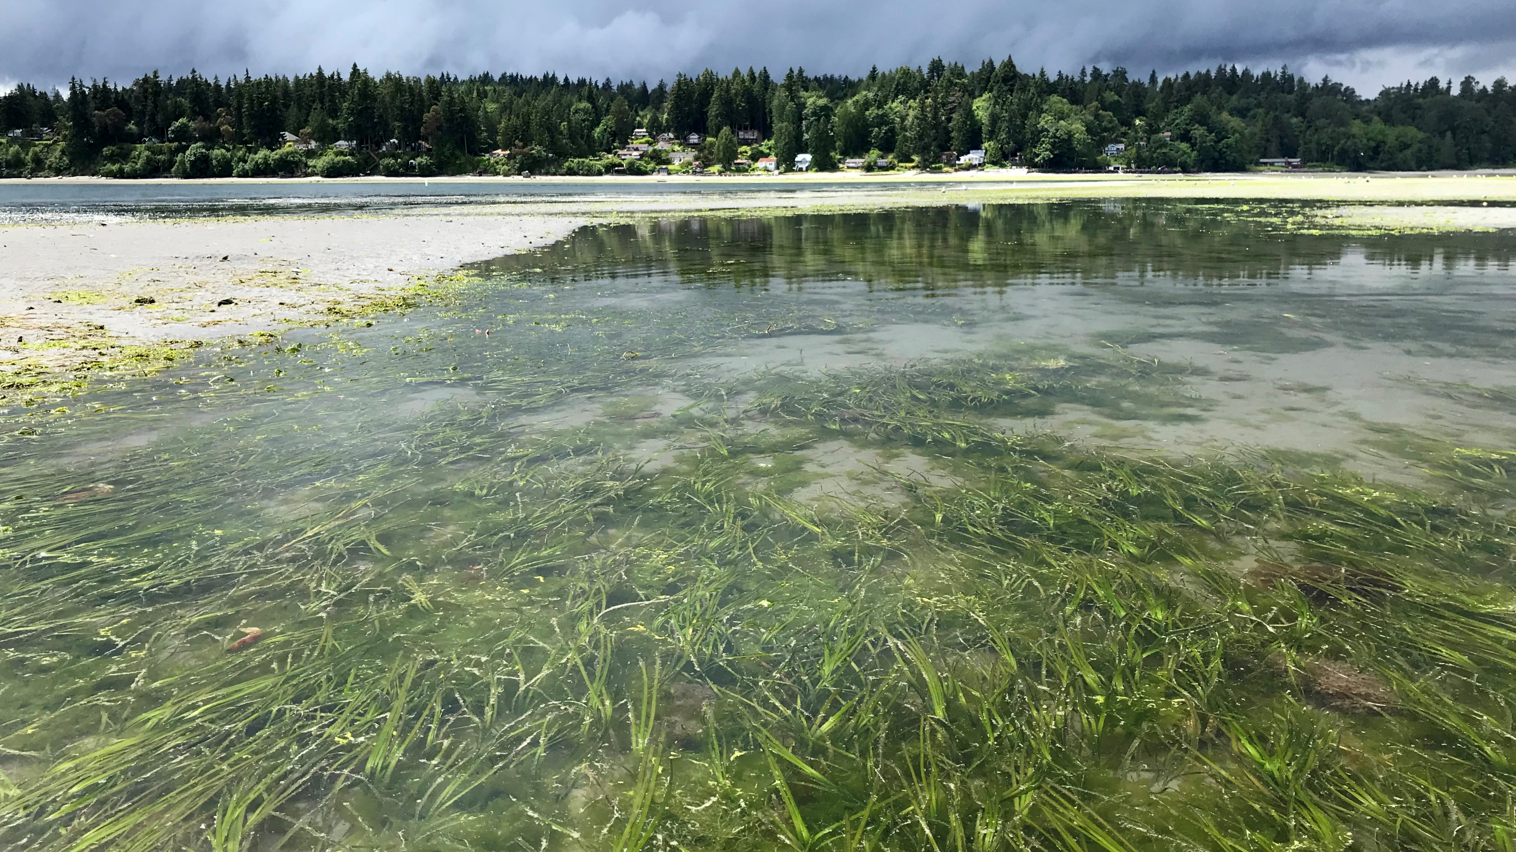
THANK YOU
epi@kitsappublichealth.org
kitsappublichealth.org

Slide 43

APPENDIX
kitsappublichealth.org/data
Notes:
Optional section divider

Slide 44

Equitable Health Data Resources
Schwabish and Feng, 2021. Do No Harm Guide: Applying Equity Awareness in Data Visualization. The Urban Institute. Accessed August 2024: https://www.urban.org/research/publication/do-no-harm-guide-applying-equity-awareness-data-visualization
Public Health – Seattle & King County, 2024. Equitable Language Guide. Accessed June 2024: https://cdn.kingcounty.gov/-/media/king-county/depts/dph/documents/about-public-health/equity-community-partnerships/phskc-equitable-language-guide.pdf?rev=884cf1320d124c7a94cb96c5e35b1567&hash=97E975791A88F572859C1FB2FDC4C607
Urban Indian Health Institute, 2020. Best Practices for American Indian and Alaska Native Data Collection. Accessed July 2024: https://www.uihi.org/resources/best-practices-for-american-indian-and-alaska-native-data-collection/
Radley et al., 2024. Advancing Racial Equity in US Health Care: the Commonwealth Fund 2024 State Health Disparities Report. Accessed August 2024: https://www.commonwealthfund.org/publications/fund-reports/2024/apr/advancing-racial-equity-us-health-care?utm_campaign=Advancing%20Health%20Equity&utm_medium=email&_hsenc=p2ANqtz-80eGQW7XkIy7tXt2F4fGLSE29A3sB0D9AeBmTey9XMcz-eWWkBvh2akbdAhlqF-aEttG1CgUSDPvRMleBJVF7S9ehlyVkgwPbBPKGqvxe2NiGExR4&_hsmi=303268336&utm_source=alert
U.S. Department of Health and Human Services, Office of Minority Health, 2023. Advancing Equity for Asian American, Native Hawaiian, and Pacific Islander Communities in COVID-19 Response Efforts: Data Disaggregation Resource Guide. Rockville, MD: US Department of Health and Human Services, Office of Minority Health. Accessed June 2024: https://s3.us-gov-west-1.amazonaws.com/cg-d102dd1b-a880-440b-9eae-e2445148aee9/s3fs-public/documents/AANHPI-Data-Disaggregation-Resource-Guide_Final_508c_6.14.23.pdf
The Urban Institute, 2024. Do No Harm Guide: Crafting Equitable Data Narratives. Accessed July 2024: https://www.urban.org/sites/default/files/2024-04/Do_No_Harm_Guide_Crafting_Equitable_Data_Narratives.pdf
Breastfeeding Public Health Partners, 2024. Equity and Inclusive Language Toolkit. Accessed July 2024: https://www.naccho.org/uploads/downloadable-resources/BPHP-Toolkit.pdf
kitsappublichealth.org/data

Slide 45
Share out
Does anyone have updates for the group?
kitsappublichealth.org
Notes:
Optional section divider

Slide 46

THANK YOU!
equity@kitsappublichealth.org
kitsappublichealth.org

