Slide 1



Kitsap Health Equity Collaborative March 17, 2026
Planning Specialist, Public Health Emergency Preparedness and Response
Planning Specialist, Public Health Emergency Preparedness and Response
Erica Whares
Equity Coordinator
Equity & Performance
Nathan Anderson
Planning Specialist, Public Health Emergency Preparedness and Response

Slide 2

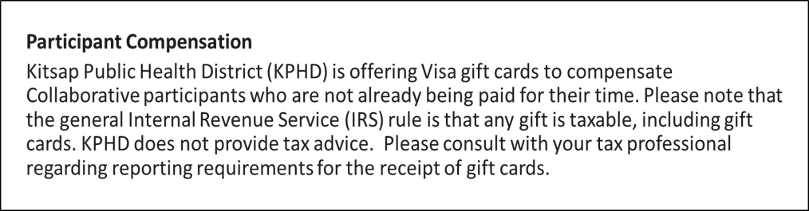
Welcome
kitsappublichealth.org
Notes:
Optional section divider; photo can be replaced using right click > Change Picture

Slide 3
Agenda
Welcome and reminders, KPHD Updates
Workgroup Updates
Tough Love Campaign
Public Health Emergency Preparedness workshop
Group share-out and closure
kitsappublichealth.org

Slide 4
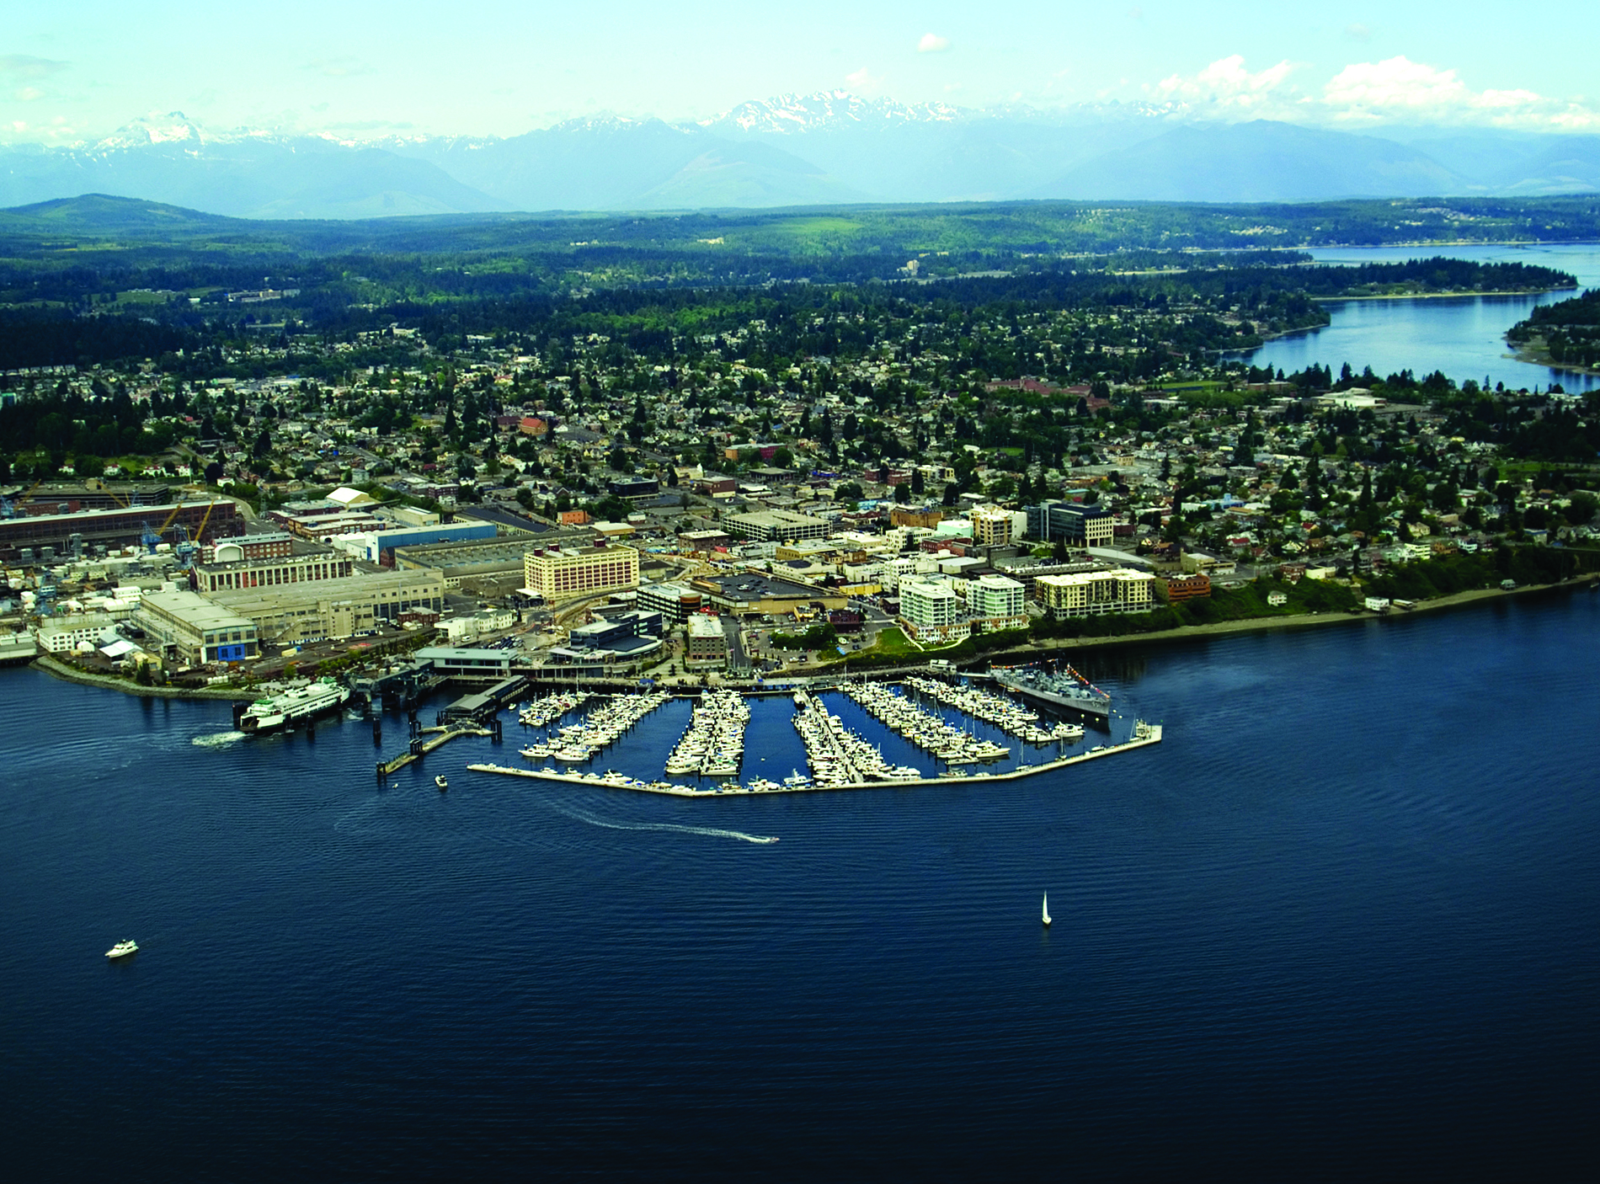
Health Equity Collaborative
OUR VISION
Everyone in Kitsap County can achieve their optimal health and safety, and no one is disadvantaged in achieving these outcomes because of systemic inequities or systems of oppression, including racism.
OUR MISSION
The Kitsap Health Equity Collaborative convenes to identify and implement shared solutions and collective actions, promote pro-equity policies, and amplify the voices of communities most affected by systemic inequities, including racism.
kitsappublichealth.org
Notes:
We will start with the HEC’s vision/mission slide to ground ourselves in why we are here.

Slide 5

Collaborative Agreements
Respect:
We will use respectful and inclusive language to honor different lived experiences and perspectives, recognize individual biases and systems/ structures of oppression, assume good intent, and distinguish that intent doesn’t negate impact, and keep sensitive information shared at meetings confidential.
Consensus:
We understand consensus is desired as the decision-making process and that differing opinions are part of the process, and while majority vote will determine next steps, the opinions of those in the minority will be honored by members with respect, inclusion, and open-mindedness.
Inclusion and
Open-mindedness:
We will honor the contributions of all members and seek and value every person’s input by ensuring everyone has a chance to comment and by being open to different and opposing perspectives and opinions.
kitsappublichealth.org
Notes:
Do I have a volunteer or volunteers to read the collaborative agreements to set the tone for our meeting?

Slide 6



Workgroup share-out
Accessible Medical Care
Accessible Mental Health Services
Affordable Housing
kitsappublichealth.org
Notes:
Optional section divider

Slide 7
Tough Love: Connection is Overdose Prevention.
Naomi Levine, PhD
Community Liaison,
Chronic Disease & Injury Prevention
Notes:
Alternate title slide; vertical blue line can be moved and adjusted

Slide 8

Campaign Overview
Funding from Opioid Abatement Funds
February-June 2026
Localization of a campaign that was researched and created by the National Association of County and City Health Officials (NACCHO) for International Overdose Awareness Day in 2025
kitsappublichealth.org/love

Slide 9

Tough Love
This campaign was designed to promote destigmatized interpersonal communication between adults reduce the harms of substance use, including overdose.
Punishment, judgement, and stigma isolate and push people further away, cutting off the very lifeline that could save them when they need it most.
Real human connection is the most powerful way to protect those we care about. It opens the door to trust, offering people the chance to see their own strength, make safer choices, and seek the help that everyone deserves.
kitsappublichealth.org/love

Slide 10

kitsappublichealth.org/love

Slide 11
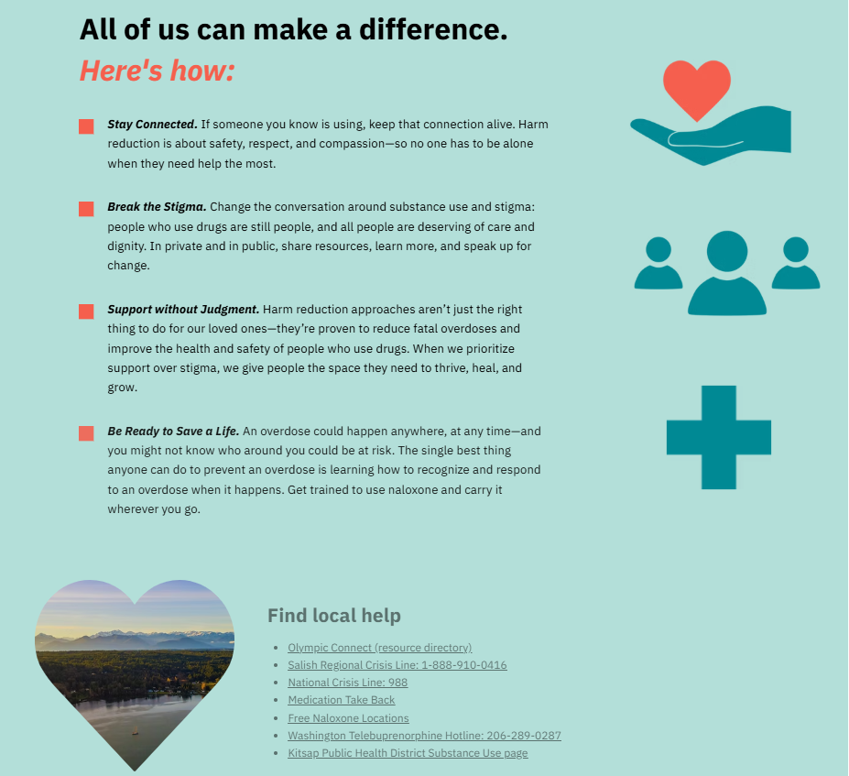
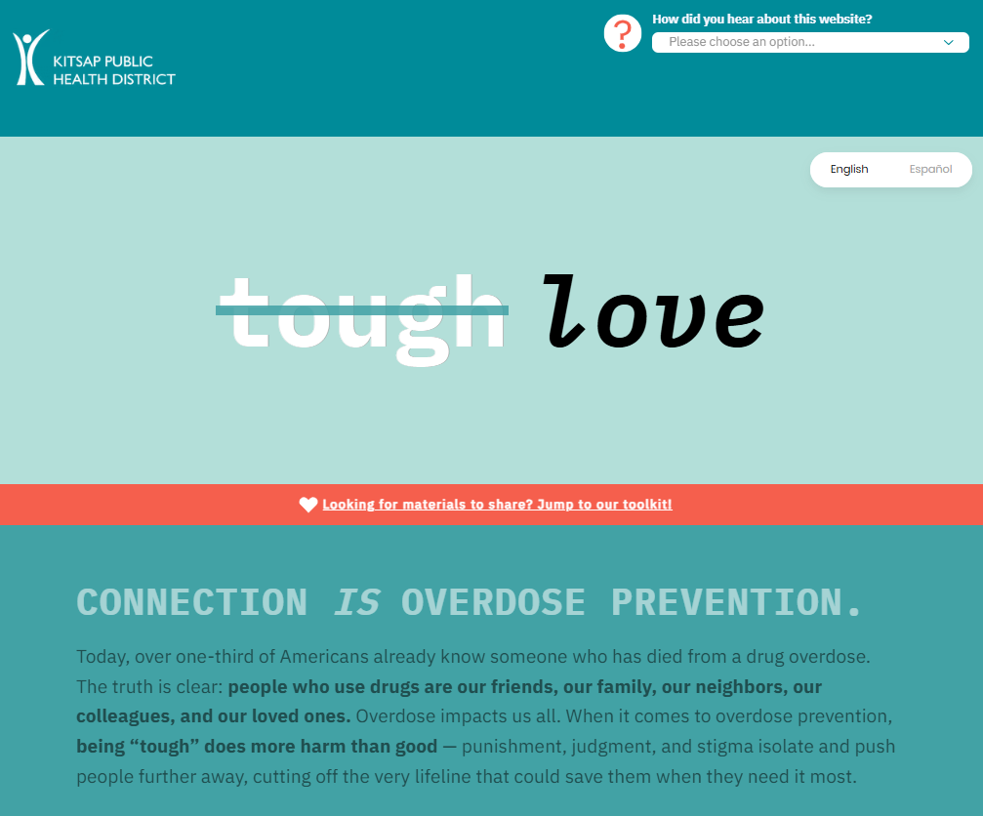
Website
kitsappublichealth.org/love

Slide 12

Partner toolkit
Available at:
kitsappublichealth.org/love
kitsappublichealth.org/love

Slide 13

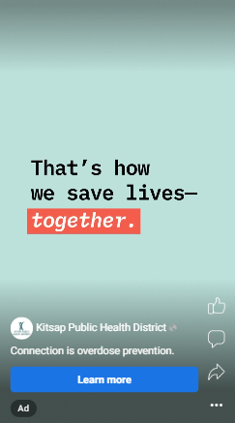
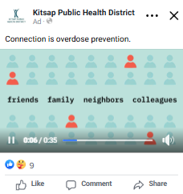
Media
Paid advertising:
Social media & YouTube
Shopping cart ads
Smokestack
Roxy Theatre
Additional media:
Website
Email/text bulletins
BKAT PSAs
Outreach through partners
News media outreach
kitsappublichealth.org/love

Slide 14
Community Engagement in Public Health Emergency Planning
{ DATE}
Nathan Anderson
Planning Specialist
Public Health Emergency Preparedness and Response
Notes:
Title slide; vertical blue line can be moved and adjusted

Slide 15
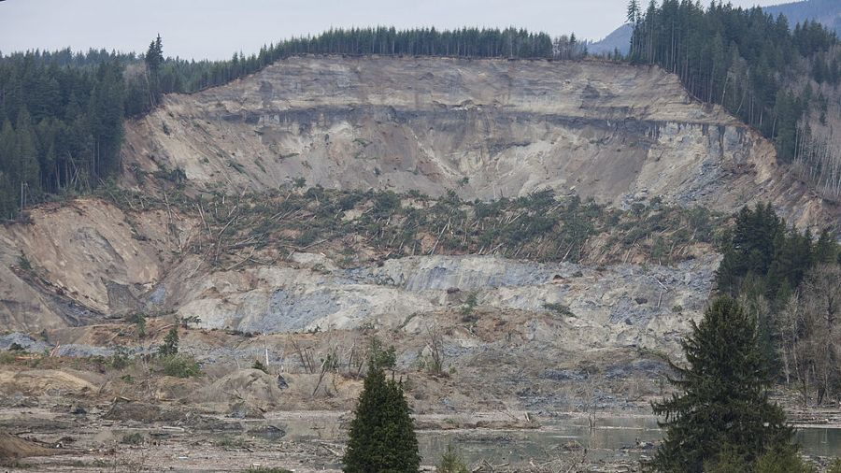
What is Emergency Management?
The goal of Emergency Management is to limit the impact of disasters as much as possible, and respond to them when they do occur
Focus on building and strengthening resilience in communities
Emergency response partners use a common approach to increase effectiveness
2014 Oso landslide
kitsappublichealth.org

Slide 16
Where does KPHD fit into this?
Same goals, but with a focus on the public health and healthcare impacts of disasters
kitsappublichealth.org

Slide 17
Where does KPHD fit into this?
Same goals, but with a focus on the public health and healthcare impacts of disasters
Our Mission
Prevent disease and protect and promote the health of all people in Kitsap County
kitsappublichealth.org

Slide 18
Where does KPHD fit into this?
Same goals, but with a focus on the public health and healthcare impacts of disasters
Our Mission
Prevent disease and protect and promote the health of all people in Kitsap County
Our Mission in an Emergency
Prevent disease and protect and promote the health of all people in Kitsap County
kitsappublichealth.org

Slide 19
Where does KPHD fit into this?
Same goals, but with a focus on the public health and healthcare impacts of disasters
Our Mission
Prevent disease and protect and promote the health of all people in Kitsap County
Our Mission in an Emergency
Prevent disease and protect and promote the health of all people in Kitsap County
The difference? Our priorities depending on how the disaster affects our health
kitsappublichealth.org

Slide 20
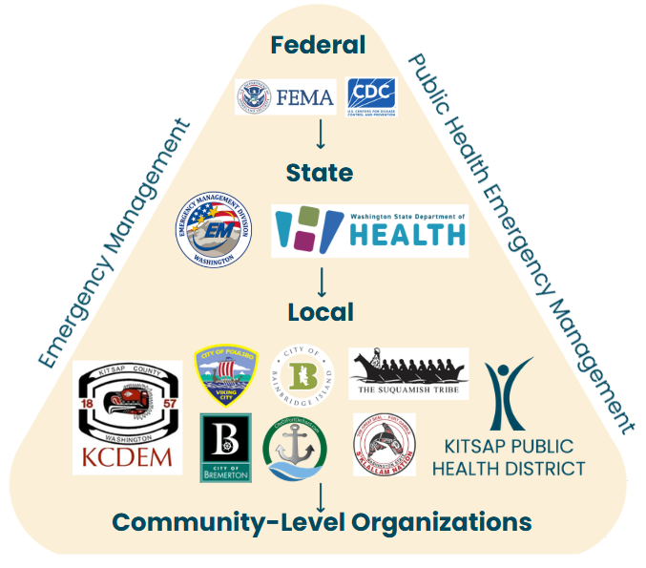
Where does KPHD fit into this?
Public Health Emergency Management
Focuses on the management of emergencies with serious health impacts
kitsappublichealth.org

Slide 21
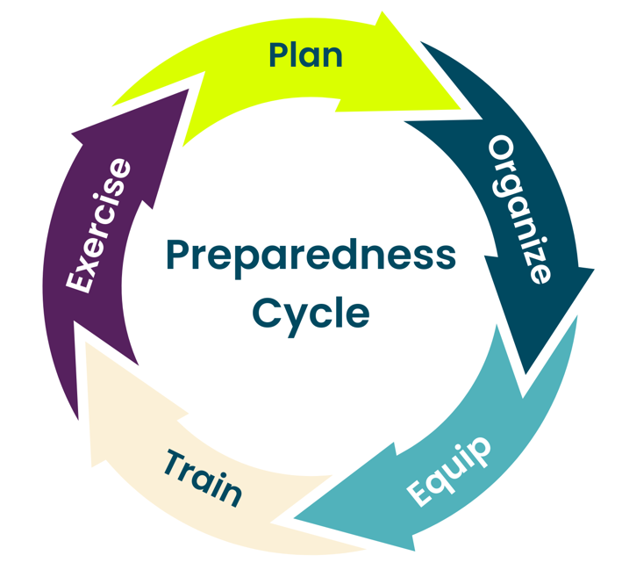
How do we do this in practice?
kitsappublichealth.org

Slide 22
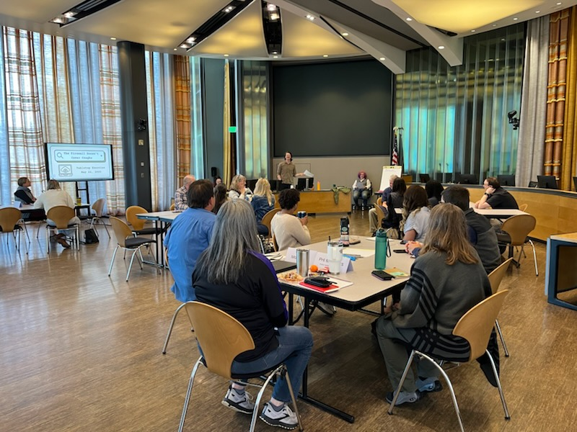
Focusing in on planning
Our plans are updated every few years, whether they are used or not
We work to identify strengths and areas for improvement
The process of planning can be just as important as the plan itself – this is where relationships are built
kitsappublichealth.org

Slide 23
Receiving Community Input
Today’s goal: identify more ways to incorporate community voices into the planning process
This is necessary to make sure our plans are effectively and appropriately preventing disease and protecting and promoting the health of all people in Kitsap County
kitsappublichealth.org

Slide 24
Receiving Community Input
What are we doing already?
Working with colleagues to better understand the unique needs in our community through detailed data gathering
Engaging with community partners/members through a variety of forums
Learning lessons from other public health agencies
kitsappublichealth.org

Slide 25
Discussion
Have there been conversations in your community about emergencies?
How have you gotten information about emergencies in the past?
From your perspective, what would engagement look like in the following areas?
1. Understand the needs of the whole community
2. Engage and empower all parts of the community
3. Strengthen what works well in communities on a daily basis
kitsappublichealth.org

Slide 26

THANK YOU!
Nathan.Anderson@kitsappublichealth.org
kitsappublichealth.org

Slide 27

Share out
Does anyone have updates for the group?
kitsappublichealth.org
Notes:
Optional section divider

Slide 28
THANK YOU!
equity@kitsappublichealth.org
kitsappublichealth.org

